Slide 1
Career Planning
Notes:
Recommended Facilitation Time: 45 mins
FACILITATOR GUIDE:
Career Planning has many facets, setting goals and expectations for yourself will push you to be your best version.

Slide 2
Enabling Objectives
Discuss the importance of Career Planning
Define a contract obligation, reenlistment, extension, zone of enlistments, and Military Service Obligation (MSO)
Define the purpose of CDBs per the Career Counselor Handbook, NAVPERS 15878N
Identify Individual Career Development Plan (ICDP) discussion topics
Identify Advancement Manual for Enlisted Personnel of the U.S. Navy and U.S. Navy Reserve, BUPERSINT 1430.16G
Notes:
FACILITATOR GUIDE:
Review objectives

Slide 3
Enabling Objectives (cont.)
List eligibility requirements for commissioning programs OPNAVINST 1420.1B
Discuss First Term Sailors Military Service Obligation (MSO)
Identify U.S. Navy Reserve programs
Identify basic Transition Assistance Program (TAP) procedures
Notes:
FACILITATOR GUIDE:
Review objectives

Slide 4
References
OPNAVINST 1040.11F - Navy Enlisted Retention And Career Development Program
NAVPERS 15878N - Career Counselor Handbook
BUPERSINST 1430.16G - Advancement Manual for Enlisted Personnel of the U.S. Navy and U.S. Navy Reserve
OPNAVINST 1420.1B - Commissioning Programs Manual
OPNAVINST 1900.2D - Transition Assistance Program
Notes:
FACILITATOR GUIDE:
Review references

Slide 5
References (cont.)
My Navy Portal, Career Planning- https://www.mnp.navy.mil/group/career-planning/ladr
Navy Credentialing Opportunities Online (COOL)-https://www.cool.osd.mil/usn/resources_and_links/index.html?
Enlisted Community Manager page- https://www.mynavyhr.navy.mil/Career-Management/Community-Management/Enlisted/Administration/
Enlisted Detailing- https://www.mynavyhr.navy.mil/Career-Management/Detailing/Enlisted/
Notes:
FACILITATOR GUIDE:
Review references

Slide 6
Common Acronyms Use
PRD (Projected Rotation Date) - The month and year the member is due to transfer from current command
EAOS (Expiration of Active Obligated Service) - The specific date member’s active-duty service obligation expires
SEAOS (Soft Expiration of Active Obligated Service) - EAOS plus any inoperative extensions to enlistment/reenlistment contract
ADSD (Active-Duty Service Date) - First day of member’s active-duty enlistment
Contract Obligation - Minimum year or months required to complete a tour (OBLISERV - Obligated service)
PAR - (Personnel Action Request) NAVPERS 1306/7 - Formal request used by enlisted Sailors to initiate or recommend personnel-related actions through their chain of command
Notes:
FACILITATOR GUIDE:
Review definitions
PAR- Also mention that PARs can be submitted electronically also (e-PAR)

Slide 7
Career Planning
What is Career Planning and why does it matter?
Importance of Career Planning
How Planning impacts promotion, retention, and transition options.
Taking ownership of your Navy career means understanding that no one cares more about your future than you do. You're in charge of your growth, success, and opportunities so stay informed, set goals, and make the most of every resource the Navy offers!
Our goal is to educate and empower first-term Sailors with the tools, knowledge, and mindset they need to make informed decisions about their Naval careers from the start.
Notes:
FACILITATOR GUIDE:
Discuss the importance of career planning and how it relates to promotion, retention and transition.

Slide 8
Career Development Boards (CDB)
Career Development Boards (CDBs) are the primary delivery method to ensure Sailors are provided guidance to make informed career decisions based on current Navy policies, programs, and procedures. CDBs are conducted at specific timeframes and actions including.
Reporting(CDB within 60 days of reporting date)
24/48/60 Months onboard a Command
Career Decision CDB – Conducted at 18 months prior to SEAOS
Sailors can request Career Development Boards at any time. CDBs are recommended for the following career actions outside of the above requirements:
Conversion
Commissioning
Notes:
FACILITATORS GUIDE:
Presenter can explain why CDBs are important in helping Sailor plan their career with assistance from their respective chain of command.
Cover the Individual Career Development Plan (ICDP)
Mutually developed plan
Assists in achievement of personal and professional goals
Hold Sailors and COC accountable
The Sailors' take away from a CDB

Slide 9
Setting SMART Goals?
Here's an example of a SMART goal tailored for an E-3 Sailor who wants to save $5,000 in a 12-month period:
Specific: I want to save $5,000 over the next 12 months by setting aside money from each paycheck and reducing unnecessary expenses
Measurable: I will save $5,000 total, which breaks down to about $417 per month or roughly $208 per paycheck
Attainable: Based on my E-3 pay (approximately $2,200–$2,400/month base pay , I will adjust my spending habits, cut back on non-essential expenses (like dining out and subscriptions), and set up automatic transfers to a savings account.
Realistic: Saving $5,000 will help me build financial stability, prepare for unexpected expenses, and support future goals such as a car purchase, and emergency fund
Time-based: I will reach my goal within 12 months, ending by month/year (e.g., July 2026, tracking my progress monthly).

Slide 10
Military Obligation Service
(MSO)
MSO Rules:
Sailors Enlisted On or After 1 October 2020 – “4-2-2 MSO”
Serve a minimum of 4 years on Active Duty if member separates from active component after 4 years they will:
2 years in the Selective Reserve (SELRES) - Drilling Reserves, and
2 years in the Individual Ready Reserve (IRR) - Inactive/Non-Drilling.
Sailors whose rate is not available in the Selective Reserve are not required to affiliate with SELRES and will transfer directly to the IRR
Serving 6 years on Active Duty eliminates the need to serve the 2 years in the SELRES. Serving 5 years active will require 1 year in SELRES.
Notes:
FACILITATOR GUIDE:
Discuss NAVADMIN 303/23
If member does 5 years of AD, they are only required to fulfill 1 year of SELRES.
Emphasize the importance of checking you Enlistment Contract on BOL to ensure 4-2-2 obligation is in your contract.
PACT Sailors that come in with 3 year contracts or Sailors who are in ratings that are not offered in reserves do not fall under these MSO requirements.

Slide 11
Reenlistment Basic Eligibility
Reenlistment term: 2, 3, 4, 5, or 6 years
Recommended for retention by CO
Must be rated
Must be physically and medically qualified
Must have an approved MyNavy Assignment (MNA) OBLISERV
Cannot exceed High Year Tenure (HYT)
Notes:
FACILITATOR GUIDE:
Explain members must receive at least a Promotable on the most current evaluation (periodic or special) for CO’s retention recommendation.
PACT Sailors with required A-school will not be able to reenlist until they graduate from the A-school.
Member with 2 consecutive PFA failures will have to refer to NAVADMIN 043/23 (Physical Fitness Failures Reset).
Explain MNA process, When, why, and how to request MNA Obligate service.
Explain High Year Tenure (HYT) and HYT Plus Pilot (NAVADMIN 288/22).
E3 – Rated, 6 years
E4 – 10 years
E5 – 16 years
E6 – 22 years
E7 – 24 years
E8 – 26 years
E9 – 30 years

Slide 12
Zones of Enlistment
Zone A: 0 – 6 Years
Zone B: 6 – 10 Years
Zone C: 10 – 14 Years
Zone D: 14 – 20 Years
Zone E: >20 Years
Selective Reenlistment Bonus
(SRB) Zones
Notes:
FACILITATOR GUIDE:
Review reenlistment zones.

Slide 13
Extension
Extensions can be executed for minimum 1 month up to maximum 48 months
Reason for Extensions (School, PRD, HYT, etc.)
Sailor whose enlistment contract ends prior to their duty station tour lengths will be asked to obligate service (OBLISERV) to complete their prescribed tour
Notes:
FACILITATOR GUIDE:
Must be recommend for retention by CO.
Explain the difference between the terms execution date and operative date.
Execution date is the date the Sailor signed the extension.
Operative date is the date the extension goes into effect; EAOS + 1 Day.
This is not an all inclusive list, see MPM 1160-040, page 4-6 for additional reason a Sailor can extend for.
An inoperative extension will be cancelled if member reenlists. The reenlistment must take them past the number of months already obligated in their previous extensions.

Slide 14
Commissioning Programs
Basic Requirements:
U.S. Citizen
Physically qualified
Age
Testing
Recommended by your Commanding Officer
Naval Academy | Naval Academy Preparatory School (NAPS) | Seaman to Admiral (STA-21) | Medical Enlisted Commissioning Program (MECP) | Officer Candidate School (OCS)
Provides 4 years of college education Must be 17 and not older than 23 on 1 July of entrance year Unmarried with no legal responsibility to support others | Provides intensive preparation for the academic, military, and physical training curriculum at the Naval Academy Offered direct appointment to the Naval Academy Must be not older than 22 as of 1 July of the entrance year | Minimum 1000 SAT 41 ACT (combined Math/English) Two components: 8 weeks at Naval Science Institute (NSI) 36 months at NROTC university Receive full pay and allowances Eligible for advancement | Provides opportunity to commission in the Nurse Corps Minimum 1000 SAT 42 ACT (combined Math/English) Can be up to 42 years old Receive full pay and allowances Eligible for advancement | Must have a Bachelor's degree 12 weeks of officer candidate indoctrination and training 22 different fields available Each designator has its own prerequisites
Notes:
FACILITATOR GUIDE:
Additional Notes:
Other Commissioning Options: Medical Service Corps In-Service Procurement Program (MSC-IPP), Limited Duty Officer (LDO), Chief Warrant Officer (CWO), Judge Advocate General’s In-service Procurement Program (JAG-IPP), Enlisted to Medical Degree Program.
Ensure to mention MyNavyHR-references-messages where NAVADMINs will be published with more information for each fiscal year.

Slide 15
Learning & Development Roadmap (LaDR)
Guide developed to assist in mentoring/developing Sailors
Allows you to chart and track goals to include:
Skills Training
Personal & Professional Growth
Professional Military Education
Education
You can access LaDR using MyNavy Portal (MNP):
Path: Career & Life Events; Career Planning; LaDR
https://www.mnp.navy.mil/group/career-planning/ladr
Notes:
FACILITATOR GUIDE:
If unable to pull up and display online have a printed example copy on hand. See Next Slide

Slide 16
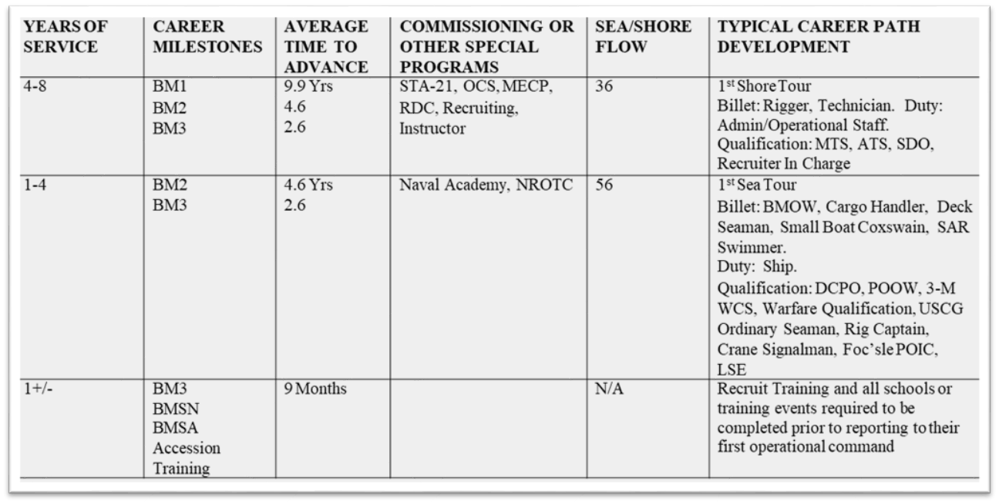
Learning & Development Roadmap (LaDR)
CAREER PATH
Notes:
FACILITATOR GUIDE:
Presenter can elaborate on how using the Career Path and LaDR would be beneficial to planning a successful Career and assisting with increased possibility for Advancement.
Explain Sea/Shore rotation
Explain the importance of obtaining qualifications.

Slide 17
Transition
Navy Selective Reserves (SELRES)
1 weekend a month and two weeks a year
2 year involuntary mobilization deferment (6 months)
1 year involuntary mobilization deferment (12 months)
Continued Tricare 6 months post Separation
Benefits of SELRES:
Reserve retirement
Pay and affiliation bonuses
SGLI/ FSGLI
Educational opportunities
Medical benefits
TAMP (Transitional Assistance Management Program)
Eligible to get activated if desired
TAMP Benefits
Notes:
FACILITATOR GUIDE:
Address submission via CWAY and who the Local SELRES Recruiter is for the respective AOR.

Slide 18
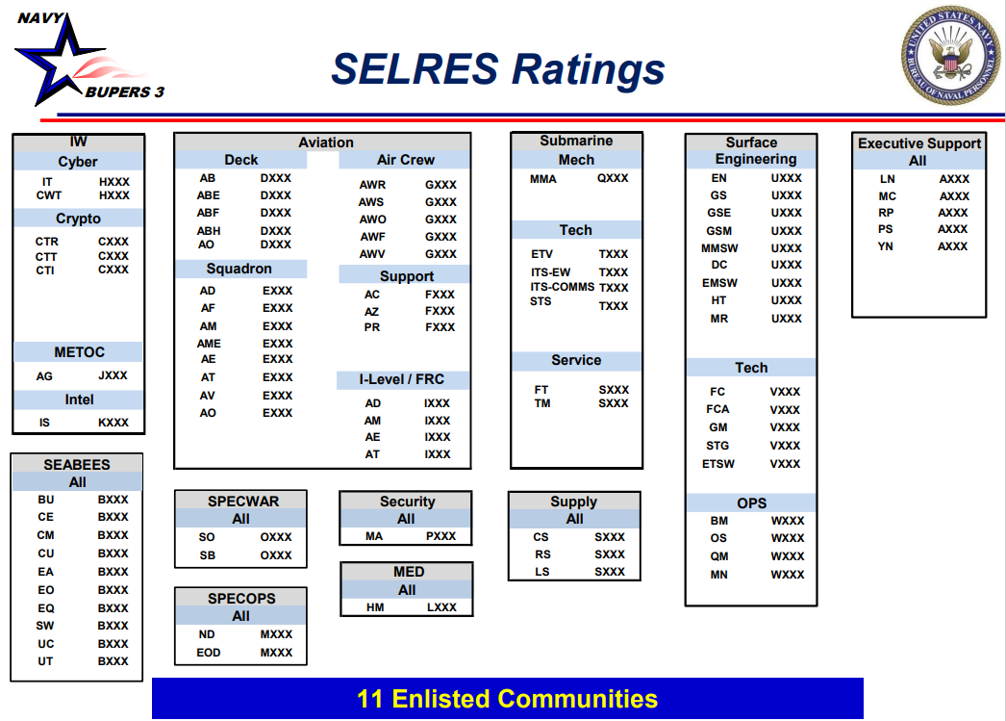
Selective Reserve
Notes:
Discuss cross-rating into a SELRES rating if member wants to affiliate.

Slide 19
Transition
Individual Ready Reserves (IRR):
Personnel fulfilling last 2 years of an 8-year military service obligation (MSO)
Not required to drill
Required to maintain physical, medical, and dental readiness standards
No pay unless activated
Notes:
FACILITATOR GUIDE:
Address submission via CWAY and who the Local SELRES Recruiter is for the respective AOR.

Slide 20
Transition Assistance Program
Provides separating and retiring service members the skills, tools and self-confidence necessary to successfully re-enter the civilian work force
Five key components of TAP
CCC
Fleet and Family Support Center (FFSC)
Self-Assessment & Initial Counseling
Pre-Separation Counseling
DOD Transition Day
VA Benefits/
DOLEW Workshop
2-Day Career Track
CAPSTONE
Must be completed no later than 90 days prior to separation
1
2
3
4
5
Mandatory
Completed 365 days from separation
DAY 1
Mandatory
Completed 365 days from separation
DAY 2
Mandatory
My Transition
Military Occupational Code Crosswalk
Financial Planning
DAY 3
Mandatory
VA Benefits
Department of Labor Employment Workshop
DAY 4 & 5
• Employment Track • Education Track • Vocational Track • Entrepreneurship Track
Notes:
FACILITATOR GUIDE:
Speak on the respective Fleet & Family Support Center for that AOR and who the TAP Coordinators are.
Discuss tier levels and which tier requires mandatory track classes.

Slide 21
Who to talk to
Chain of Command
Command Career Mentor
Leadership Support
Share your career goals early and make sure your chain of command and Career Counselor (CCC) are informed
Notes:
FACILITATOR GUIDE:
Chain of Command - Supervisors , LPOs, and LCPOs provide daily mentorship and career insight. Your first line of defense into shaping and developing your career.
Command Career Counselor – plays a crucial leadership and mentorship role in guiding Sailors through every phase of their Navy career. Think of the CCC as the go-to resource for professional development, retention, and reenlistment decisions.
Mentor – Offers Career guidance and goal setting. Having a mentor is crucial to assisting you in aligning personal values with Navy career paths. Your mentor will help you map out a plan for advancement, qualifications, and professional milestones and hold you accountable. Offers advice based on personal experiences—both successes and setbacks
Leadership Support – CO, XO, and CMC plays a pivotal leadership role in career planning for Sailors. While they may not be involved in every individual career decision, their influence sets the tone, policy, and support structure that enables effective career development across the command. Approves reenlistments, special program packages, and some rate conversion.

Slide 22
Knowledge Check
What is the acronym SEAOS ?
What is the maximum number of months that you can extend your contract?
A sailor that has been in the Navy for 5 1/2 years is in what zone of enlistment?
What are some types of CDB’s?
What are some of the basic requirements for commissioning programs?
Notes:
FACILITATOR GUIDE:
Review questions and refer to corresponding slides

Slide 23
Review and Summary
Career Development Boards
Commissioning Programs
LaDR
Military Obligation Service (MSO)
Transition
Notes:
FACILITATOR GUIDE:
Questions to ask the class:
What is the purpose of a CDB? What is the CDB Schedule? What is the PACT CDB Schedule? How many years is your MSO? Where to find LaDR? Timelines for TAP?
Presenter can tailor review questions to the audience.

Slide 24
Questions ?
Notes:
FACILITATOR GUIDE:
Questions to ask the class:
What is the purpose of a CDB? What is the CDB Schedule? What is the PACT CDB Schedule? How many years is your MSO? Where to find LaDR? Timelines for TAPS?
Presenter can tailor review questions to the audience.

